Slide 1
Airline Reservation System
Presented by
S.Anitha (06P61A0518)
CH.Vindhya (06P61A0527)
CH.Mrunalini (06P61A0542)
S.Pragnya (06P61A0560)

Slide 2
Abstract:
This project aims at reservation of a airline ticket of a customer through an agent. This system can be used to effectively manage the Reservation of Flight Ticket. Having both the Flight and Customer details within a single application can increase functionality and promote productivity.
The System will be accessible to all agents who have a valid User Id and Password. The Two databases can also be accessed individually.
The System provides the following facilities:
  To view the Flight Details
  Find the Flight Availability From Any Place
  To Know the Flight Ticket price from the starting Point
  Viewing the Types of Flight Booking
  Transactions made in the windows are reflected in the database in real-time.

Slide 3
Introduction
The Project deals with the reservation of the airline ticket of the customer by an agent. It aims to ease and book the ticket by an agent along with the customer details.
In earlier times, to reserve the airline ticket, the customer stand in a queue and wait for booking the ticket. But if the fight is not available as per the customer convenient timings then it leads to consuming the precious time of the customer for traveling to reach airport and return back to home.
In Order to overcome these problems the following application has been developed and implemented. This application helps the customer to reserve the airline ticket by making calls to agent.
The Application contains two panels namely Flight Details and Login panels that allow the agent to focus on the appropriate task. By Segmenting the work we have increased productivity and functionality.

Slide 4
Software Requirement Specification

Slide 5
System Specifications

Slide 6
Hardware Requirements
  PROCESSOR : PENTIUM IV
RAM : 128 MB
Hard Disk : 40 GB

Slide 7
Software Requirements
Operating System : Windows
Programming Language : Java (JDK1.5.0 version)
Java Technologies : Swings, JDBC
Database : Oracle 10g(xe)

Slide 8
Other Requirements

Slide 9
Functional Requirements
This section is the bulk of the document and precisely states the functions of the system – what it should do and what it should not. This section is split into subsections modeled after the real world activities like reserving tickets etc. Freedom from ambiguity and navigability were kept in mind while documentation. A consistent terminology has been followed throughout and the terms are explained in the appendix. The subsections follow a logical sequence that reflects the real world.
Non-functional Requirements
These are quality requirements that stipulate the performance levels required of the system for various kinds of activities. Numerical lower and upper limits set conditions on the response times, access times etc of the system. Sometimes, tradeoffs are necessary among various non-functional requirements.

Slide 10
Future Requirements
These are the specifications which are not provided for now in the current version of ARS but which could be incorporated into future versions. Some of these need advanced technologies and interfaces with other systems. The ARS could be designed in future to enhance the existing capabilities or add entirely new ones.
The assumptions and limitations of the ARS have been interspersed in the SRS to present the same in their proper context

Slide 11
System Objectives
The Airline Reservation System (ARS) is a software application to assist an airline with transactions related to making ticket reservations of tickets.
From the viewpoint of the airline -
Minimize repetitive work done by the system administrator and reservation clerks.
Maintain consistency among different access modes, e.g. by phone, at the information desk and across different physical locations. The users should be basically taken through the same steps by the system as they go through in conventional desk-reservation systems.

Slide 12
Maintain customer information in case of emergency, The profile can also be used by the airline company to track user preferences and travel patterns to serve them better, plan routes, for better marketing and efficient scheduling of flights.
Maximize the revenue of the airline company by various means:
  Increase awareness among frequent travelers about various special offers and discounts.
  Minimize the number of vacant seats on a flight and maximize flight capacity utilization.
  Maintain the capability to adopt a flexible pricing policy. The price of the tickets should be dynamically determined based on how early, before the date of departure, the customer buys the ticket.
  A survey conducted by airline companies shows that users of an existing reservation system would respond favorably to an ARS that satisfied or helped them satisfy the following objectives:

Slide 13
  Reduce effort and frustration for travelers in scheduling a trip, especially by reducing the search effort for the flight they need to take.
  Show all possible combinations and itineraries available for a pair of origin-destination cities.
  Reduce redundancy in the information required from the customers in order for them to buy tickets, create user accounts etc.
  Check the validity of input data and give a feedback to the user in case of errors or inconsistency.
  Protect customers’ privacy concerns.
Make it easy for travelers to check the ticket status or make changes to their trip.

Slide 14
UML Diagrams

Slide 15
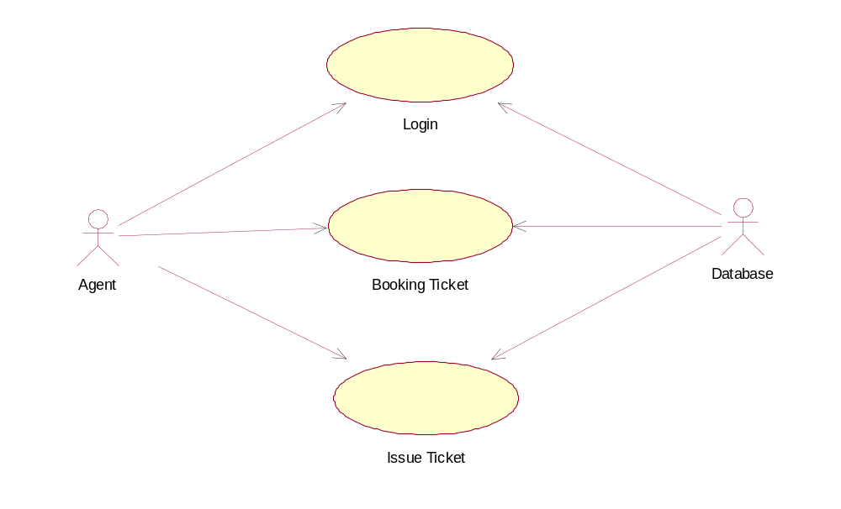
Use Case Diagram

Slide 16
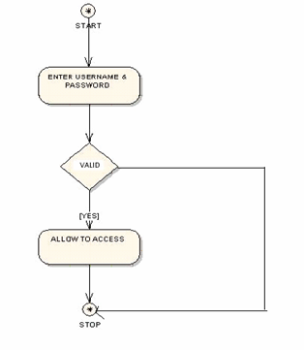
Activity Diagram 1

Slide 17
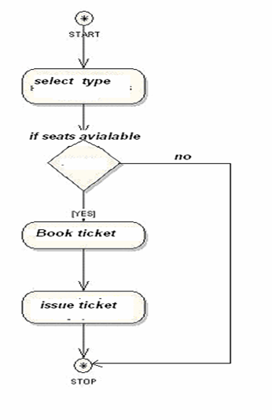
Activity Diagram 2

Slide 18
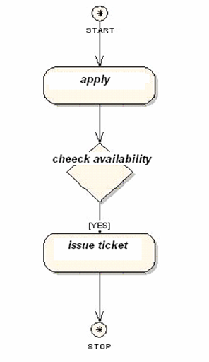
Activity Diagram 3

Slide 19
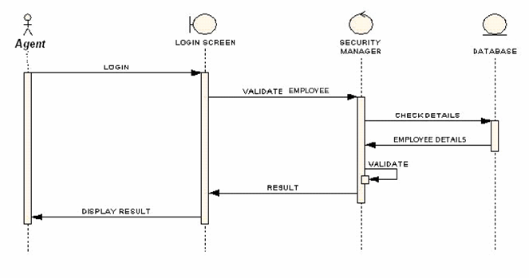
Sequence Diagram 1

Slide 20
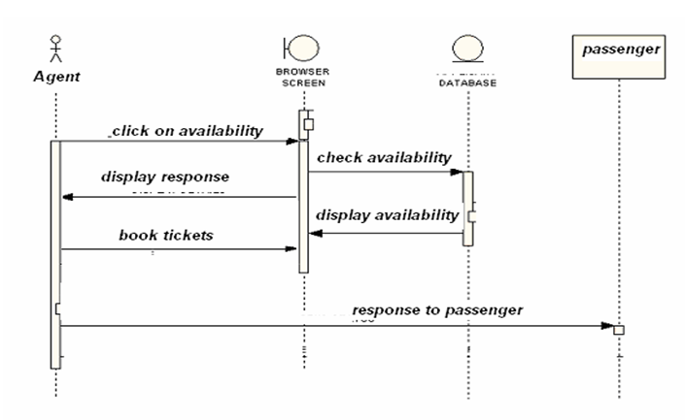
Sequence Diagram 2

Slide 21
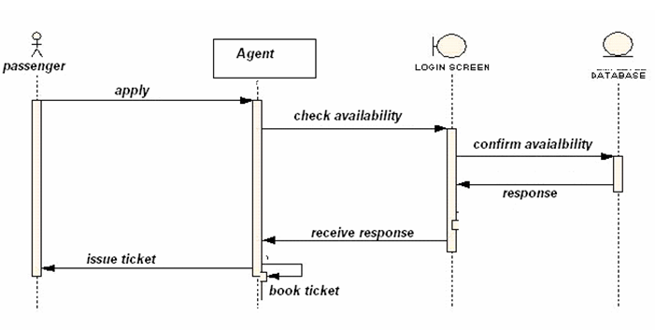
Sequence Diagram 3

Slide 22
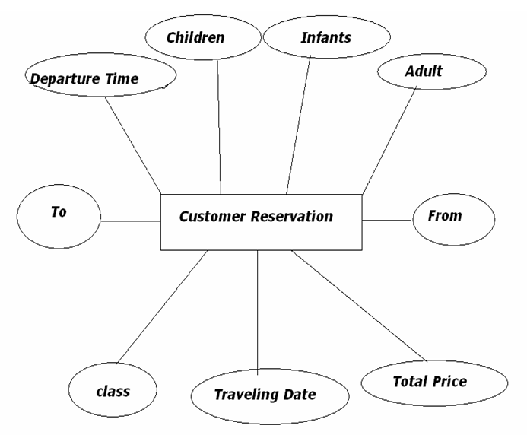
ER Diagram

Slide 23
Screen Shots

Slide 24
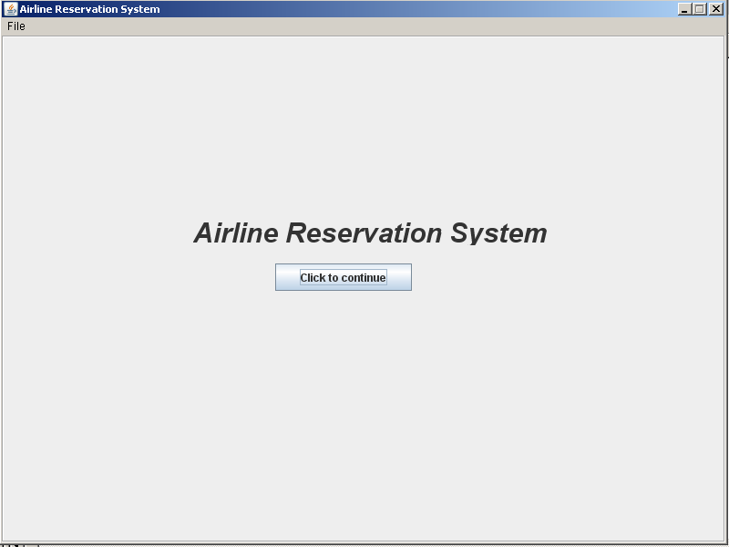

Slide 25
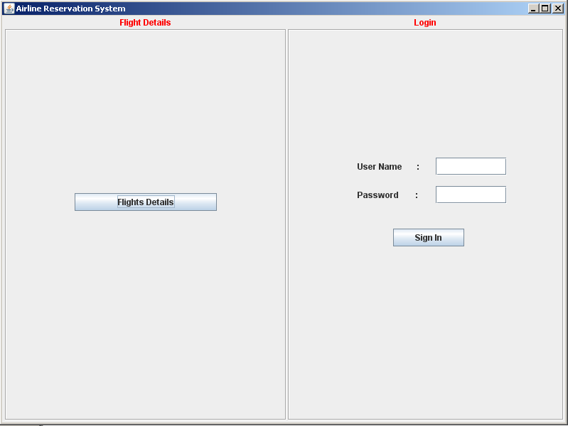

Slide 26
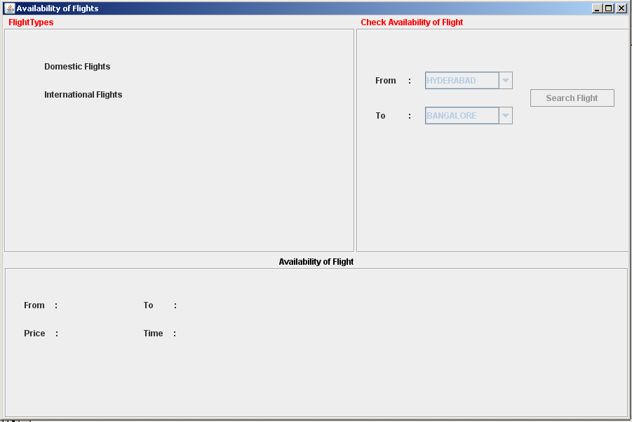

Slide 27
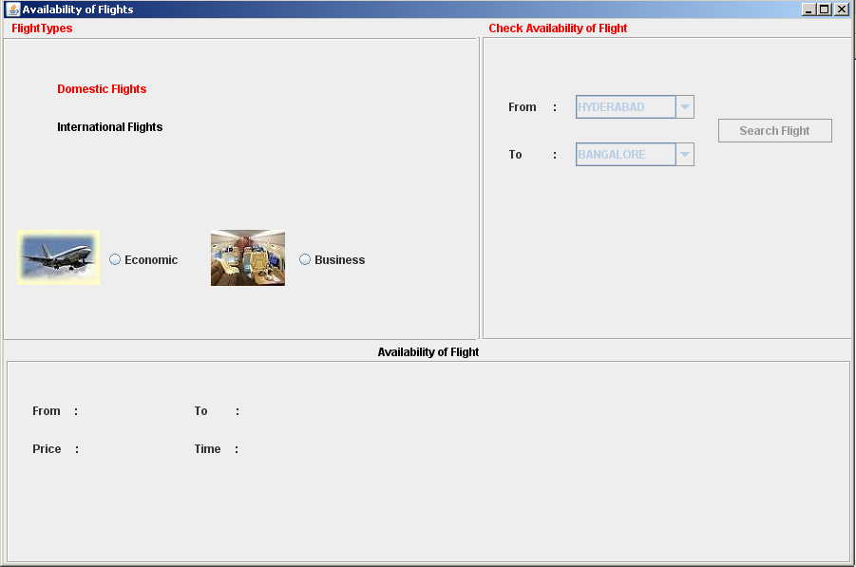

Slide 28
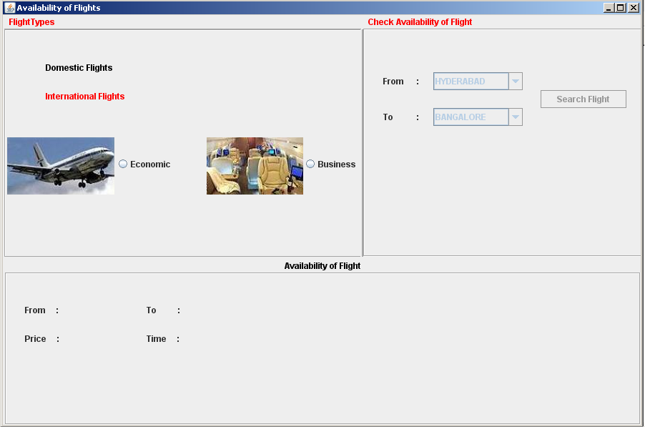

Slide 29
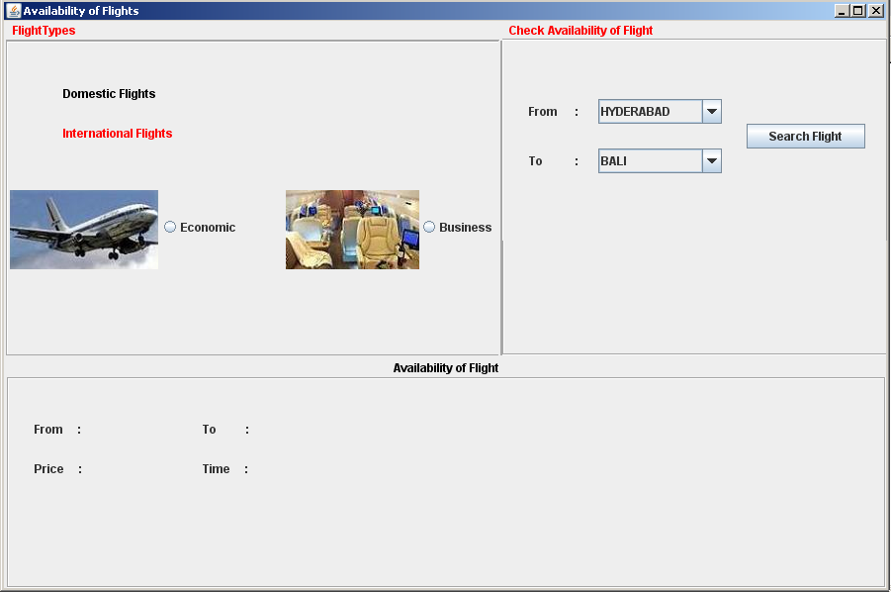

Slide 30
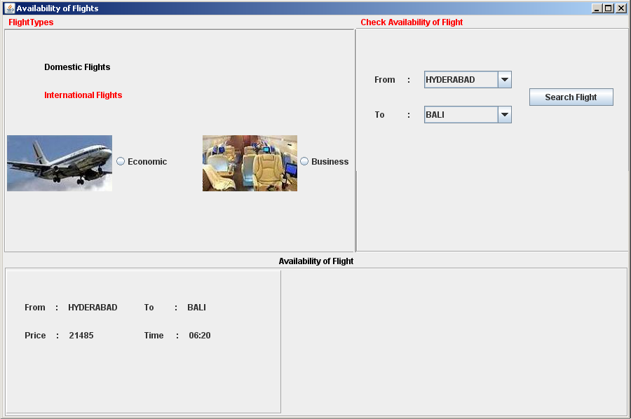

Slide 31
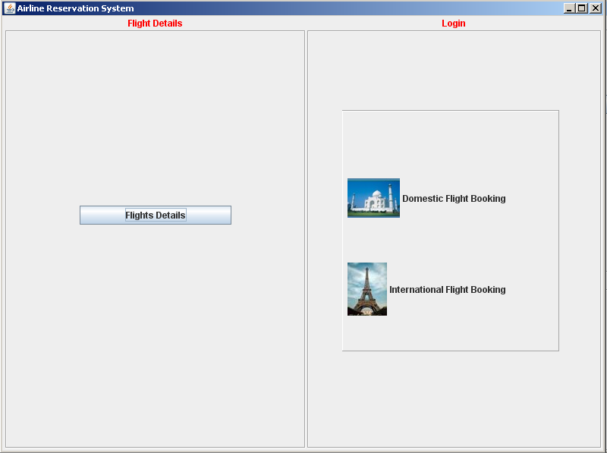

Slide 32
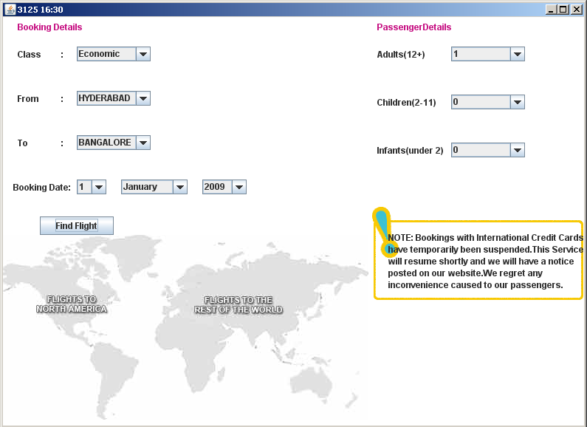

Slide 33
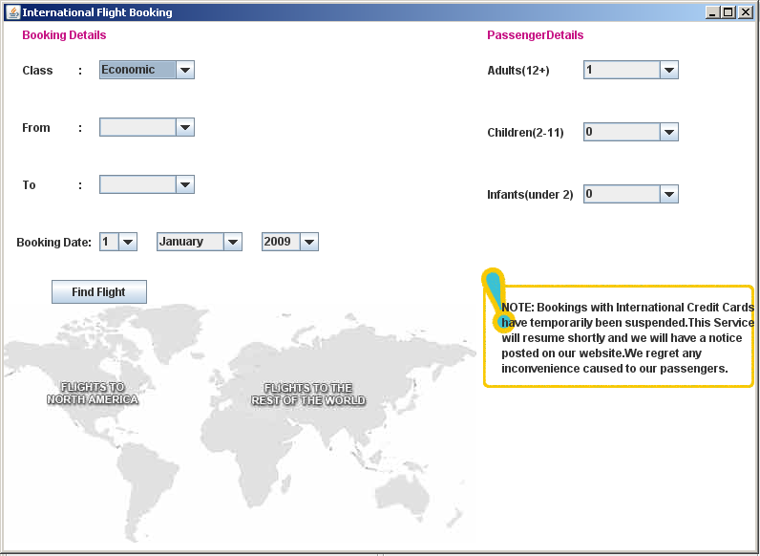

Slide 34
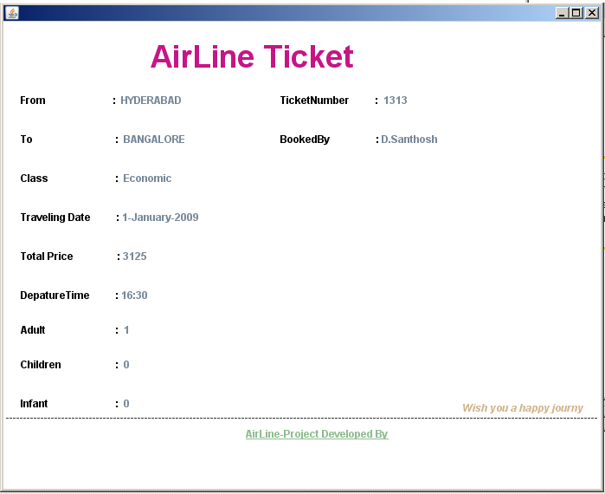

Slide 35
Thank you

